Slide 1

Online Automated Examination System For Physically Handicapped Students Using (AI and ML)

Slide 2
A PROJECT REPORT ON A PROJECT REPORT ON Online Automated Examination System For Physically Handicapped Students Using (AI and ML) BY Ms . Akshata Shirwale [34303] IN PARTIAL FULFILLMENT OF M.Sc. (Computer Science) Part I Semester II SIR PARASHURAMBHAU COLLEGE, PUNE (2022-2023)

Slide 3
INTRODUCTION
An online examination system is a digital platform that allows educational institutions, organizations, or individuals to conduct assessments and examinations electronically. It replaces the traditional pen-and-paper approach by utilizing internet connectivity and specialized software to deliver, and evaluate exams.
Writing examination could be a challenging task for the persons with disabilities. Those with physically disable and visual impairment find it difficult to read questions and write answers.
The Ministry mandates that the “extra time” should be referred to as “compensatory time”. Any person with benchmark disability and having limitation in writing exams is allowed to have a scribe/reader/lab assistant. But giving to much the “compensatory time” & “extra time” is not possible in real time examination, because is not flexible to both the student and teachers.
Another scenario if students are absent if any reason that time examination are taken (like viva and internal type small examination) difficult to conducting for those students are physically disability or cerebral palsy. These students cannot attend lectures and examination regularly on time as per college and university rules .
It also uses for many types of examination purpose like small exam which conducted on google forms. we can say that one type of replacement of examination which conducted on google form. Because when we use these type of forms faculties can not check that any malpractice and unfair was happening or not.

Slide 4
EXISTING SYSTEM
The system typically includes features such as:-
User authentication : - The system verifies the identity of the user before allowing them to access the exam.
Exam scheduling :- The system allows instructors to schedule exams and set time limits for completion.
Exam delivery :- The system delivers the exam questions and any supporting materials to the student.
Exam submission :- The student submits their answers to the system for grading.
Grading and feedback:- The system grades the exam and provides feedback to the student.
Need For New System:-
While online examination systems there are also some challenges associated with them. One of the main challenges is ensuring the integrity of the exam. Cheating can be a significant problem in online exams, and preventing it requires careful design and monitoring of the system. Another challenge is ensuring that the system is accessible to all students, including those with Physical disabilities or limited access to technology. The main purpose of these system is a student with physical disabilities they need for more time and flexibility in the exam. They don’t go into any kind of discomforts in examination.
Overall, the existing system of online examination has the potential to improve the efficiency and effectiveness of exams, but it requires careful design and implementation to ensure its success.
Overall, a new online examination improve efficiency, enhance security, and provide a more flexible and convenient assessment experience for students and educators.

Slide 5
SCOPE OF THE PROPOSED SYSTEM
The user has to register in system first, after that system allows user to login with their designated credentials . At the time of login system captures the photo of the candidate for check the valid student is give the exam or not.
The system verifies the identity of the user before allowing them to access the exam. If information of student is valid then only student access the exam otherwise not.
At the time of examination, the live face was detected by using face recognition technology and AI algorithms. System will verify image of user at every time of login and whole examination using face recognition technology. To verify an if any student cannot do any unfair or malpractice in the examination.
At the time of exam, AI (artificial intelligence) tool was speaking a question for candidates , candidates don’t need to read the question , they have to give only the answers of those question , and AI tool is automatically record and check the answers is correct or not .
Once the exam is completed, the system automatically evaluates scores, and generates results.
We Consider providing extended time allowances or scheduled breaks for candidates with physical disabilities who may require additional time or extra time.
We Provide audio-based examination to candidates with the visual impairments or other disabilities that affect reading or writing abilities.
These features include remote proctoring, which monitors students during exams using video surveillance, audio recording, and AI algorithms to detect any suspicious behaviour or unauthorized activities.

Slide 6
Advantages of proposed system
• Security of data with fast results
• Extended Time and Breaks for candidates.
• Reduced Physical Strain.
• Privacy and Independence.
• Accommodation for Specific Disabilities.
• Save the time.
• cost-effective option
• Instant Results and Feedback.
• Enhanced Security Measures.
• It provides flexibility in terms of exam scheduling and location.
• Allowing students to take exams remotely at their convenience.
• reduce examines overhead
• eliminate the need for paper, printing, and manual grading.

Slide 7
HARDWARE AND SOFTWARE REQUIREMENT
Description | Required
Processor | I5 11th generation
Ram | 8 GB
Hard Disk | 1 TB
Monitor | 15 inches Colour Monitor
Keyboard | 122 Keys
Operating System | 64 Bit
Hardware requirements :-
Software requirements :-
Front-end | Html , CSS
Back-end | Python , Flask , SQLite
Models & Algorithms | Artificial Intelligence & Machine Learning NLP (Natural Language Processing) Cosine Similarity algorithm
Platform | Windows 10

Slide 8
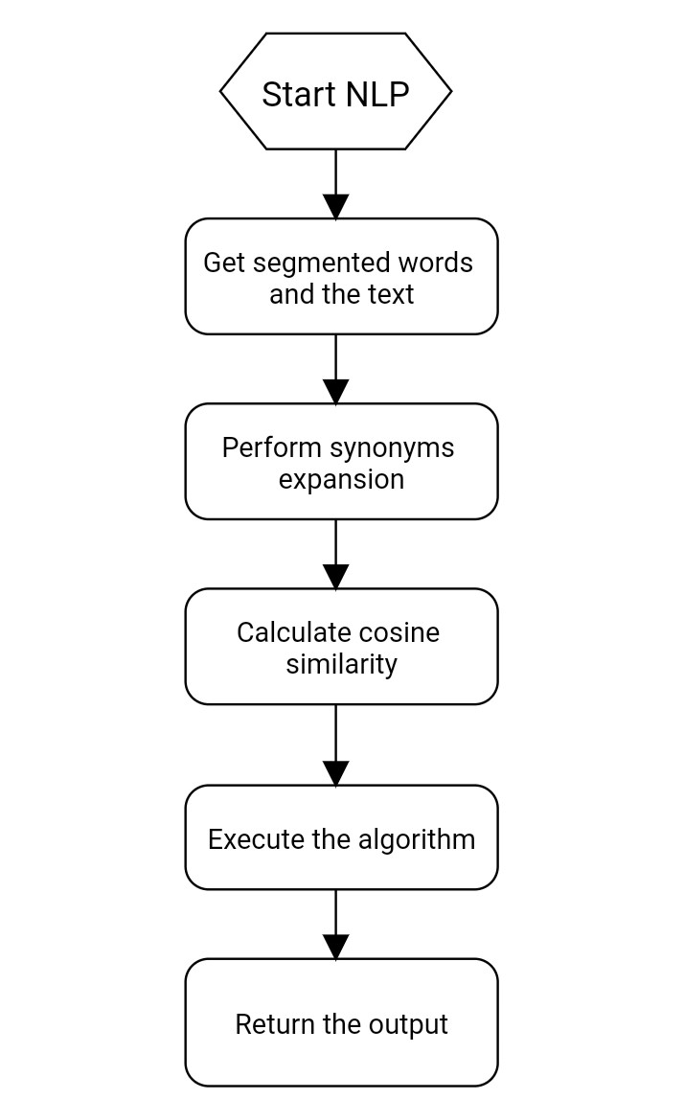
FLOWCHART

Slide 9
Process of NLP and Cosine Similarity algorithm
Text is input for Engine
Engine produces Audio
Audio is output for Engine
Microphone is input for Speech
Speech produces Text
Text is input for cosine similarity algorithm
cosine similarity algorithm compares Text with other Texts in the system
Library is dependency for both Text-to-Speech and Speech-to-Text conversion
Voice is property of Engine and can be selected for output

Slide 10
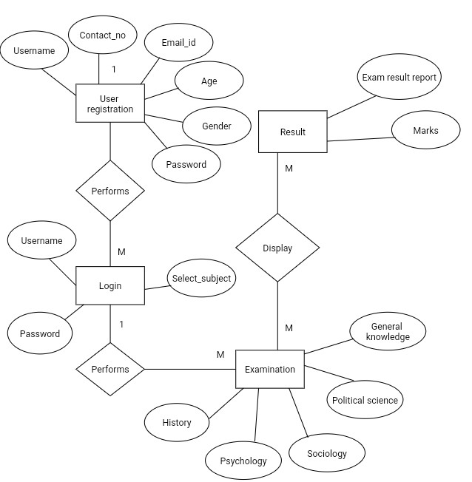
E-R Diagram
E-R DIAGRAM

Slide 11
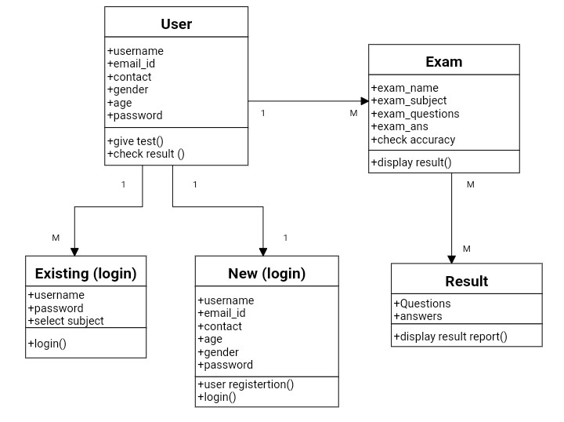
CLASS DIAGRAM

Slide 12
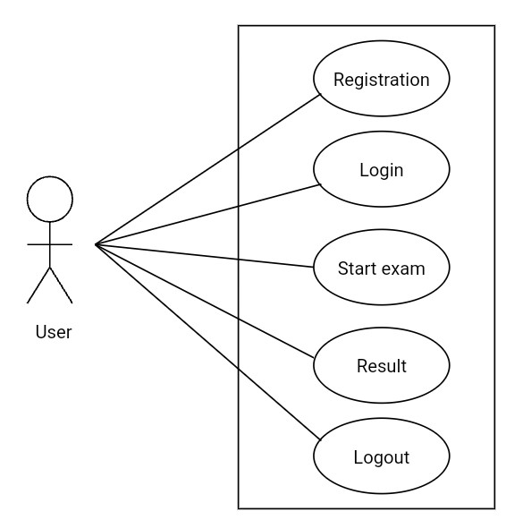
USECASE DIAGRAM

Slide 13
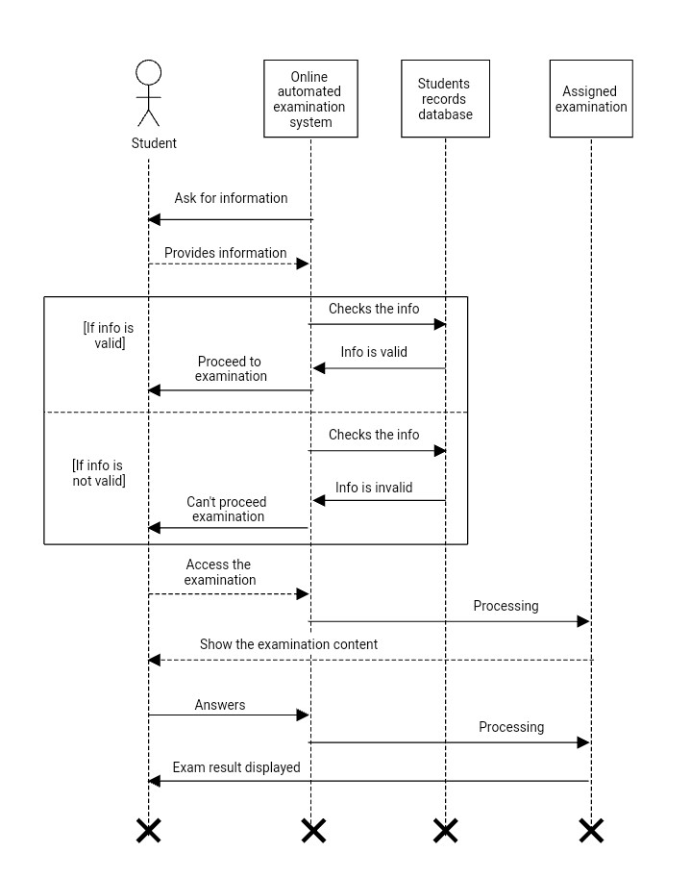
SEQUANCE DIAGRAM

Slide 14
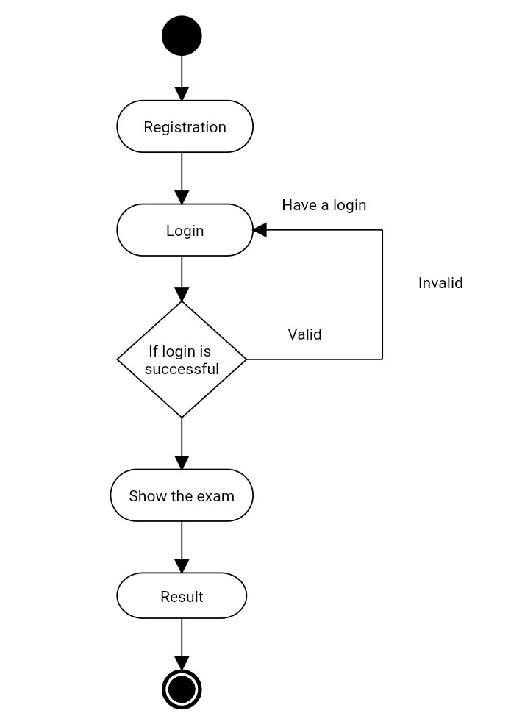
ACTIVITY DIAGRAM

Slide 15
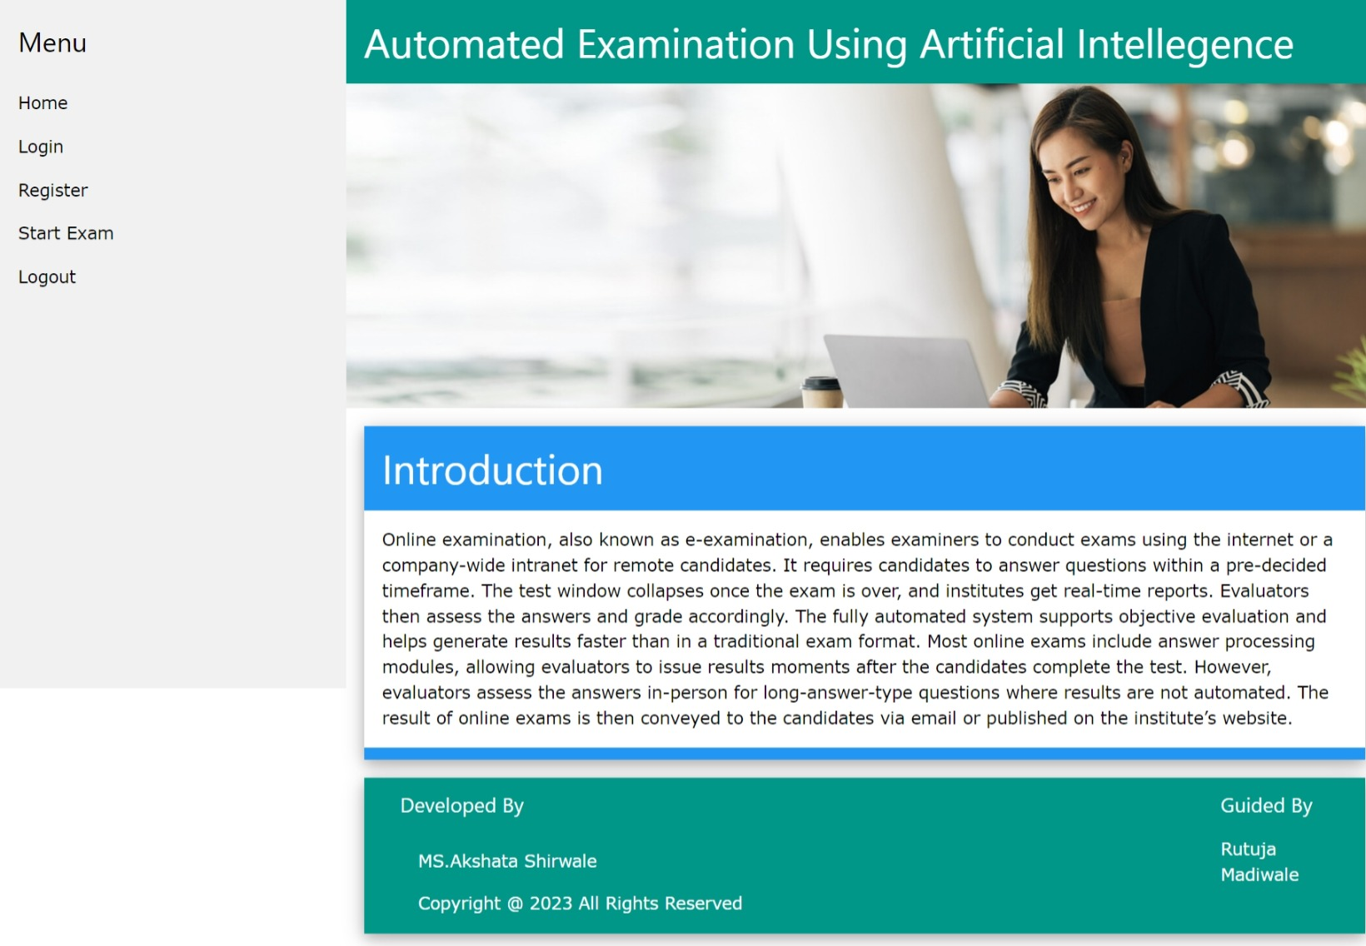

USER INTERFACE DESIGN

Slide 16
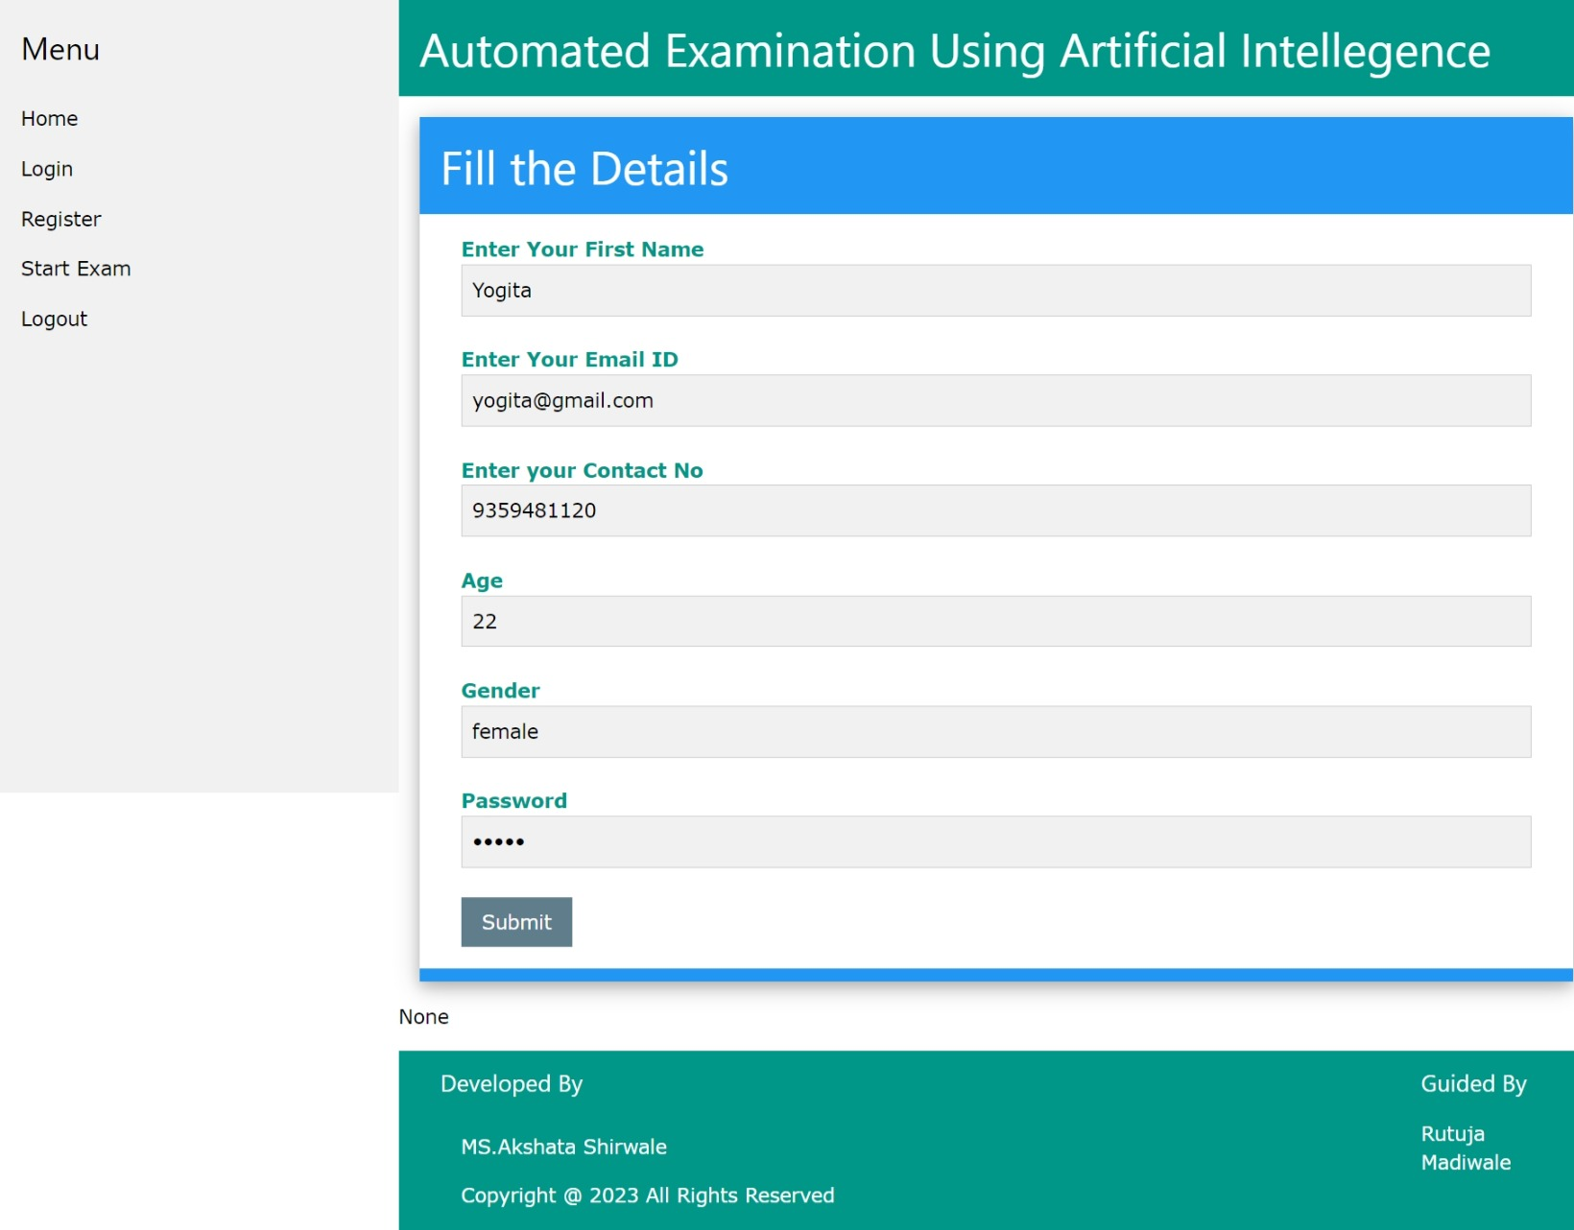
Registration page

Slide 17
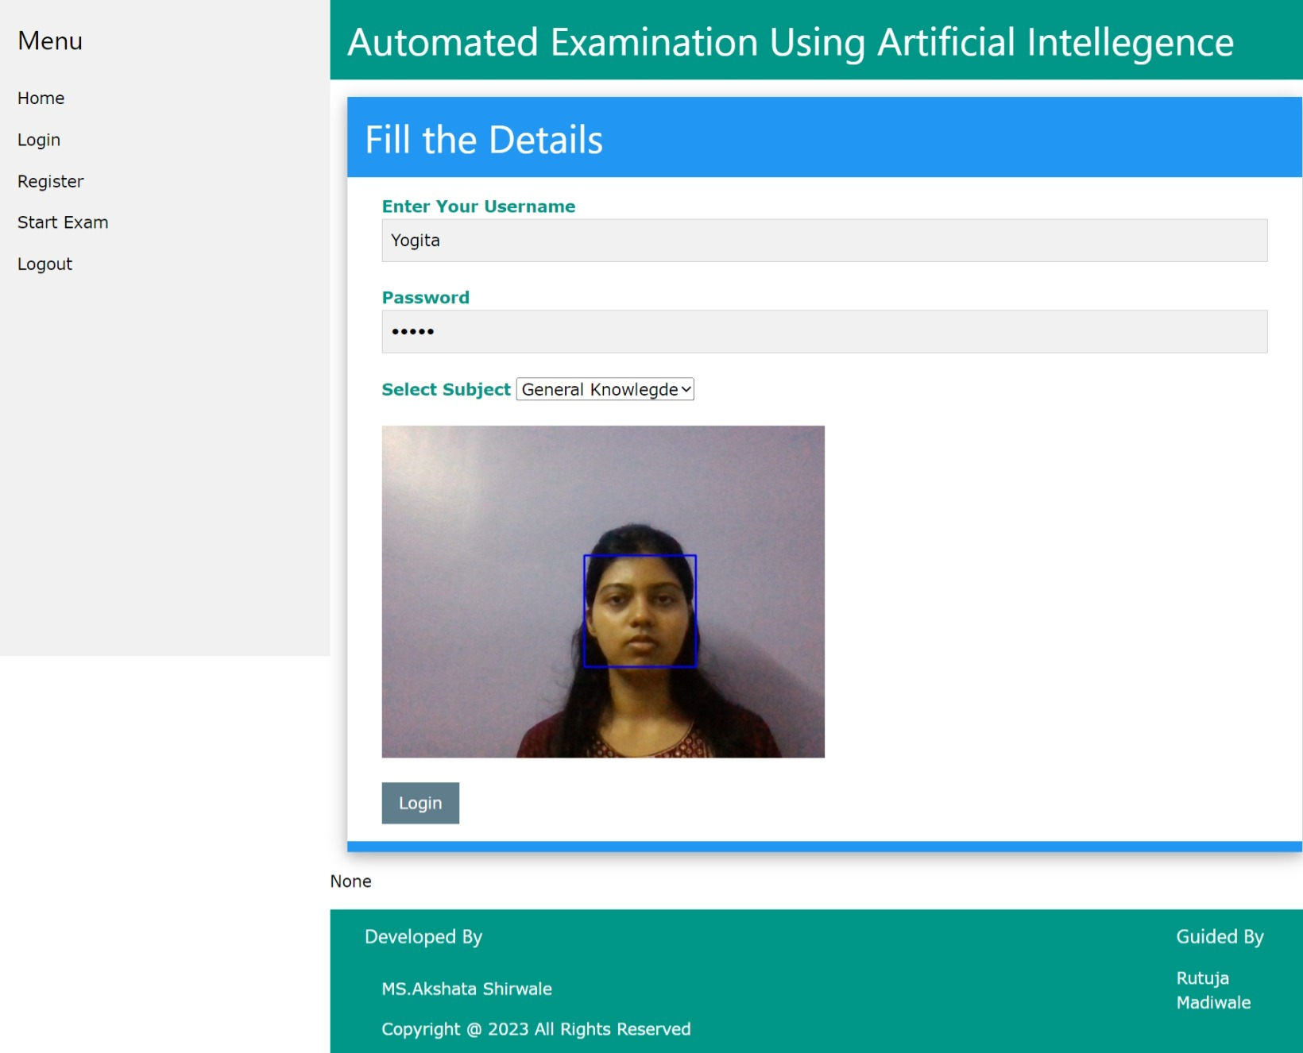
Pre-login page

Slide 18
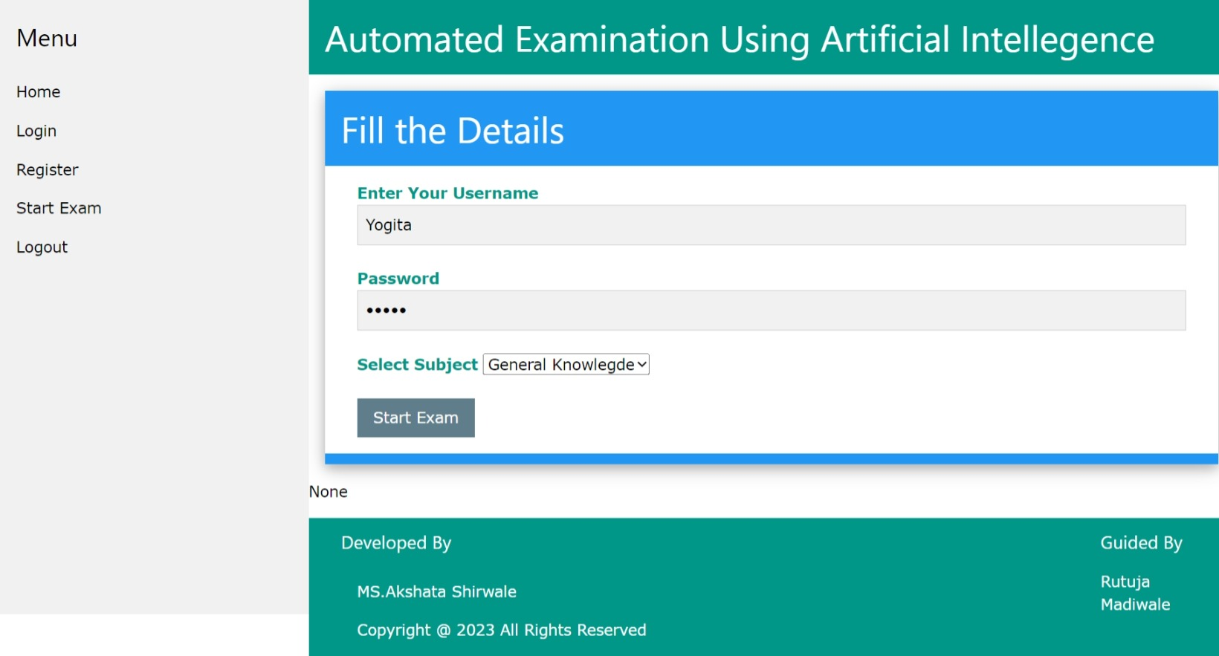
Login page

Slide 19
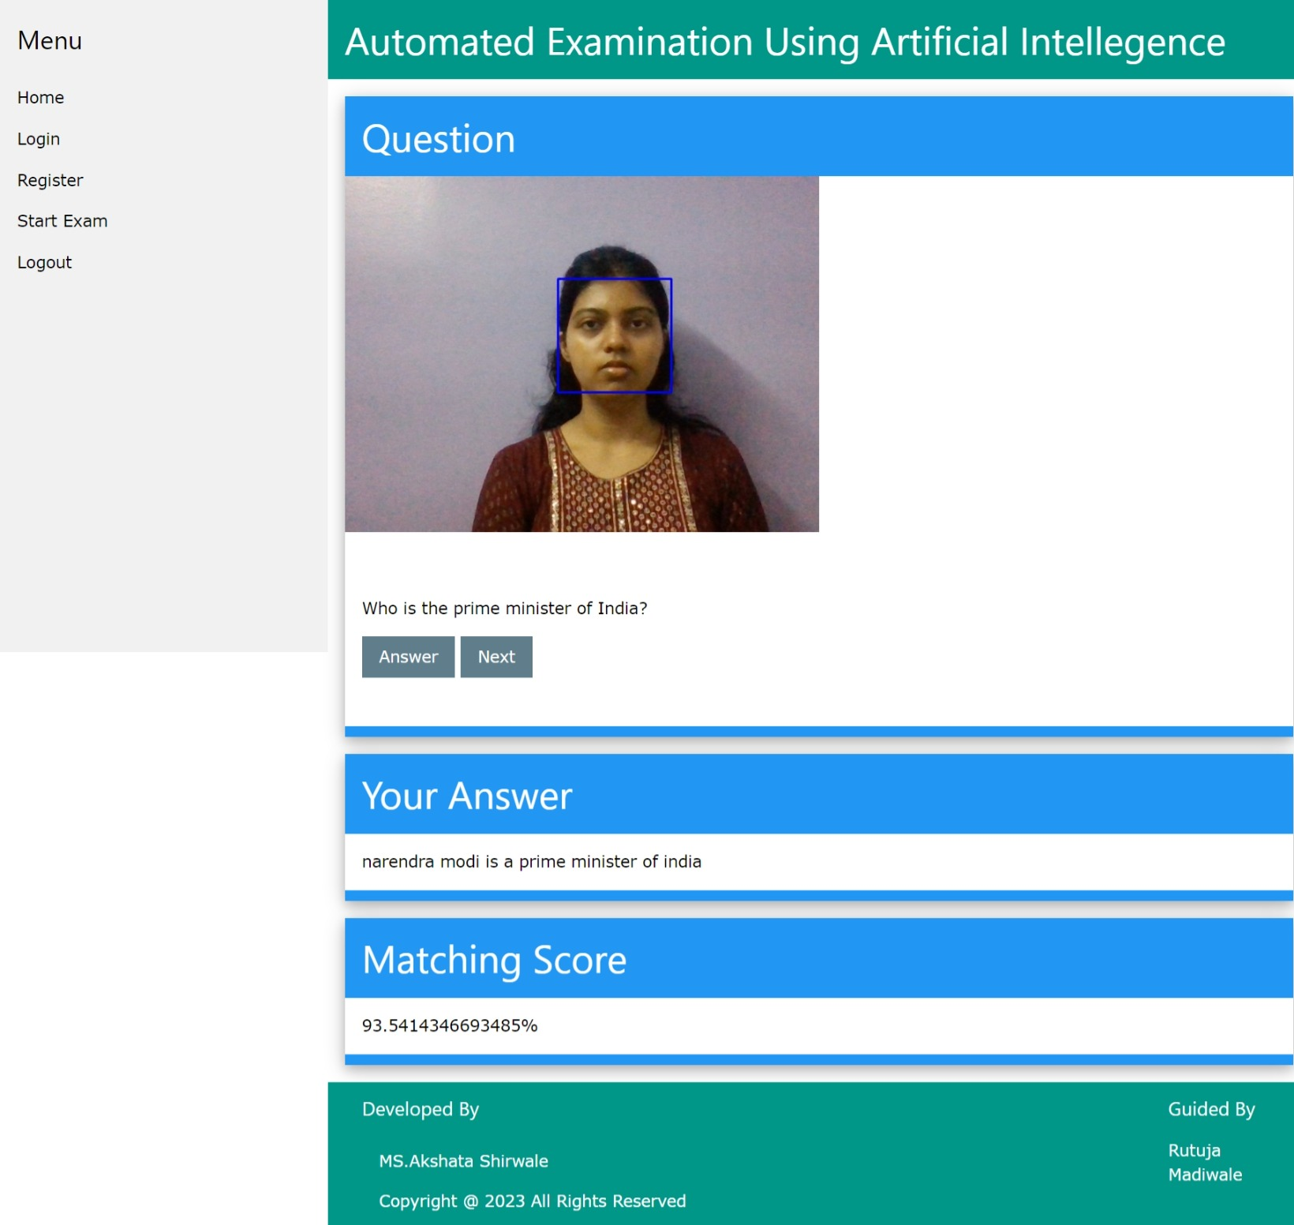
Start Exam

Slide 20
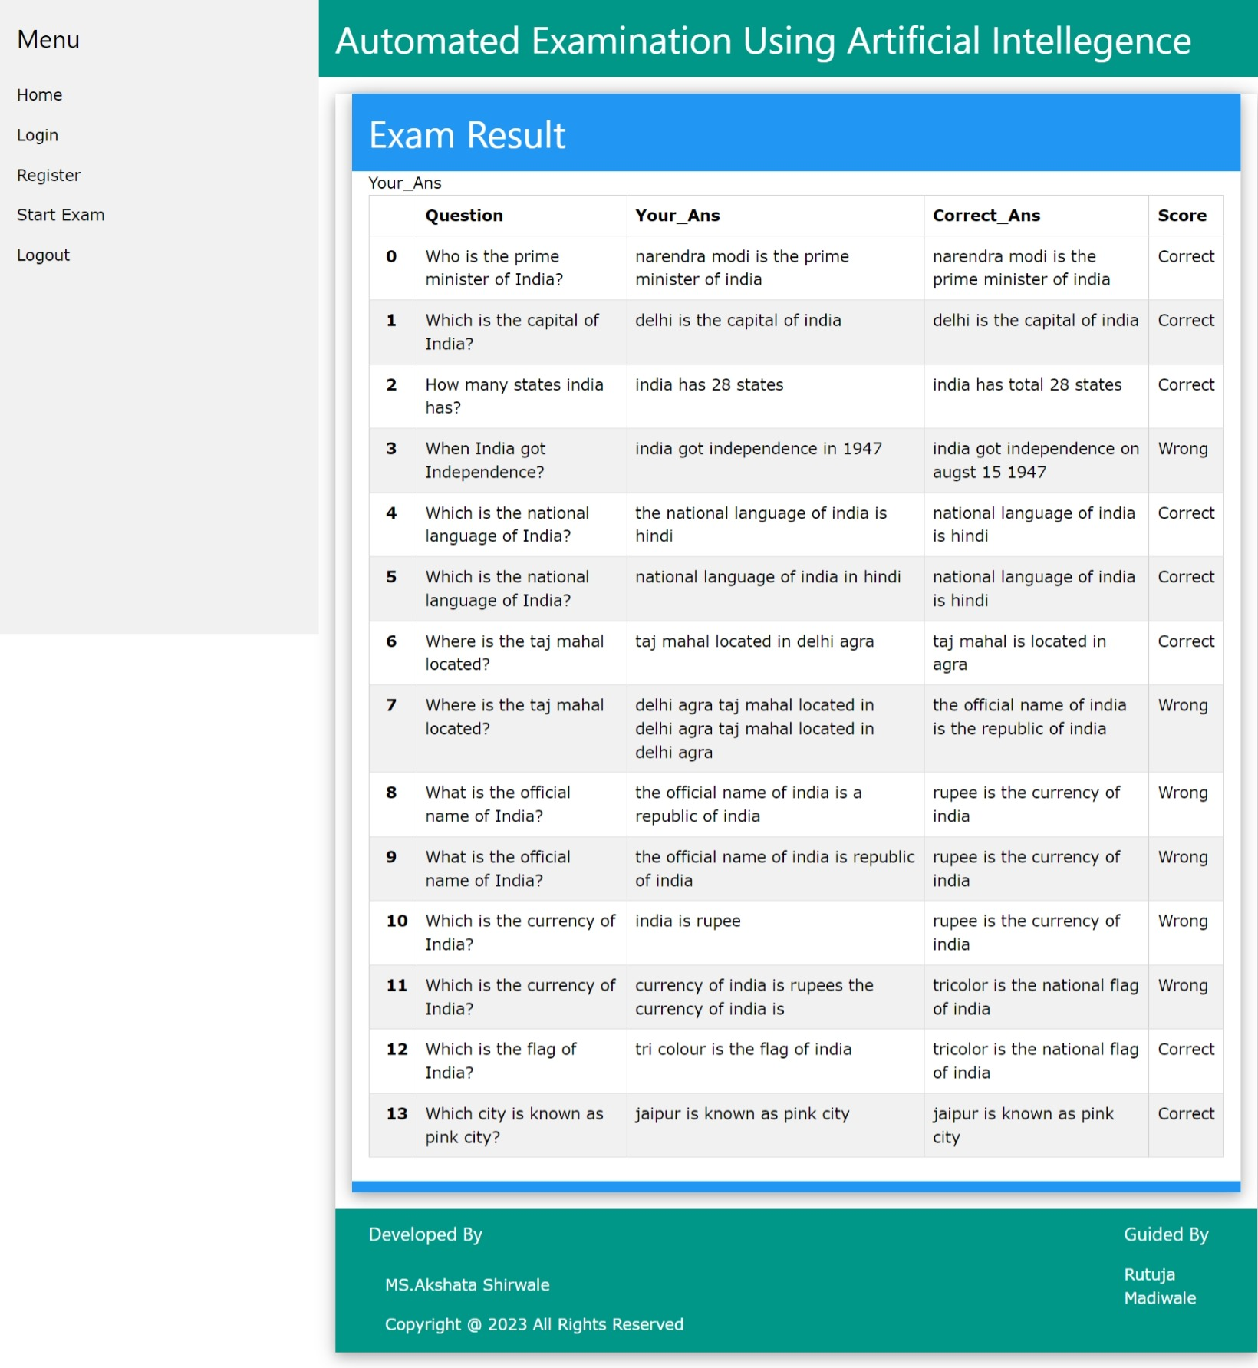
result

Slide 21
LIMITATIONS
Technical Issues
Cheating Concerns
Infrastructure Requirements
Limited Interaction
Impersonation and Identity Verification
Technological Literacy
Accessibility Challenges
Dependence on Internet Connectivity
Test Security Concerns

Slide 22
DRAWBACKS
1. Dependency on internet.
2. Dependency on power supply.
3. Dependency on camera and microphone.
4. Server failure.
5. Lack of Personalized Attention.
6. System Compatibility Issues.
7. Internet Bandwidth Limitations.
8. Limited Use of Hands-On Assessments.
9. Cost of Implementation. .
10. Technical issues.

Slide 23
PROPOSED and future ENHANCEMENT
Secure Authentication
Flexible Question Types
Real-time Feedback
Accessibility Features
Mobile Compatibility
System Scalability

Slide 24
THANK YOU

